Slide 1

When2Work
First Account Login
Click to Begin

Slide 2
Error!
Please follow the on-screen
instructions to continue.
Go Back

Slide 3
Complete
Please navigate to the next module
in the course to continue.
Restart Course

Slide 4
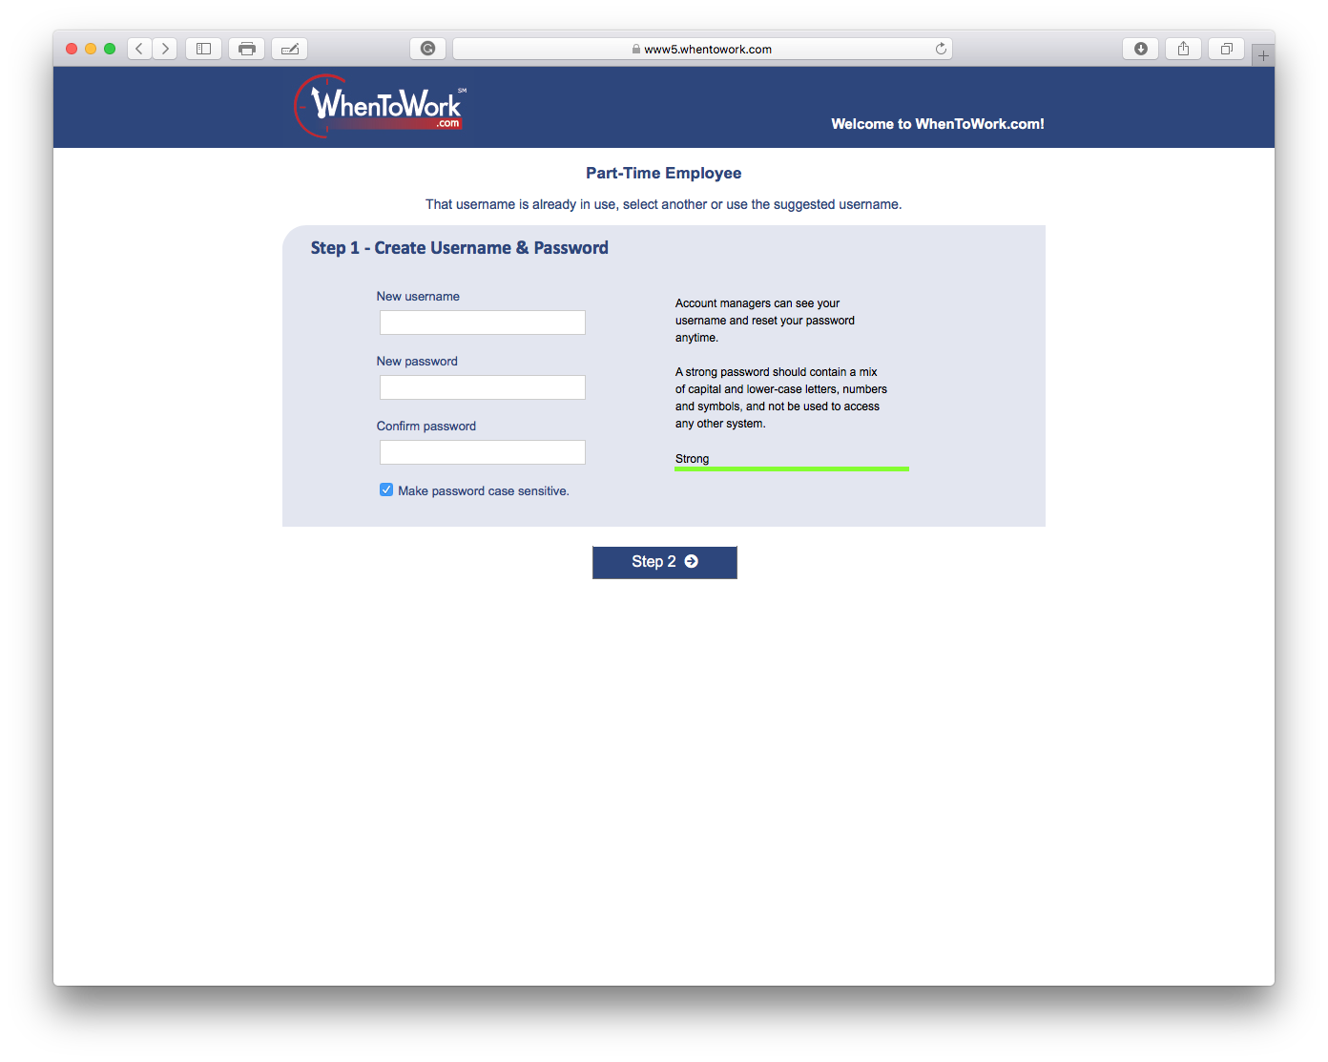
Tip:
Create Your Username
You will use this when you login

Slide 5
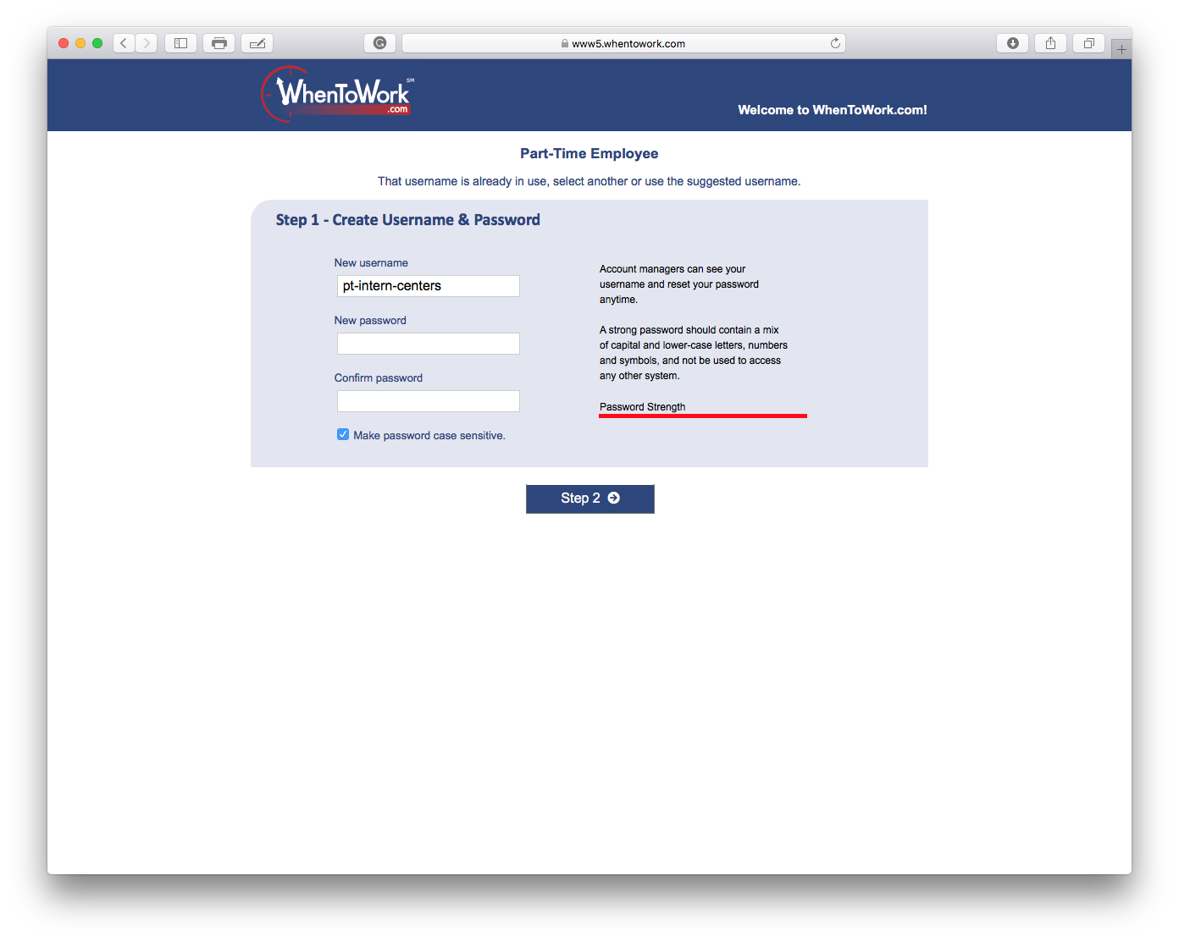
Tip:
Create Your Password
This is different than your desktop login!

Slide 6

Tip:
Confirm Your Password
Take note so you do not lose it!

Slide 7

Tip:
Click to jump to Step 2
Step 2 is optional*

Slide 8
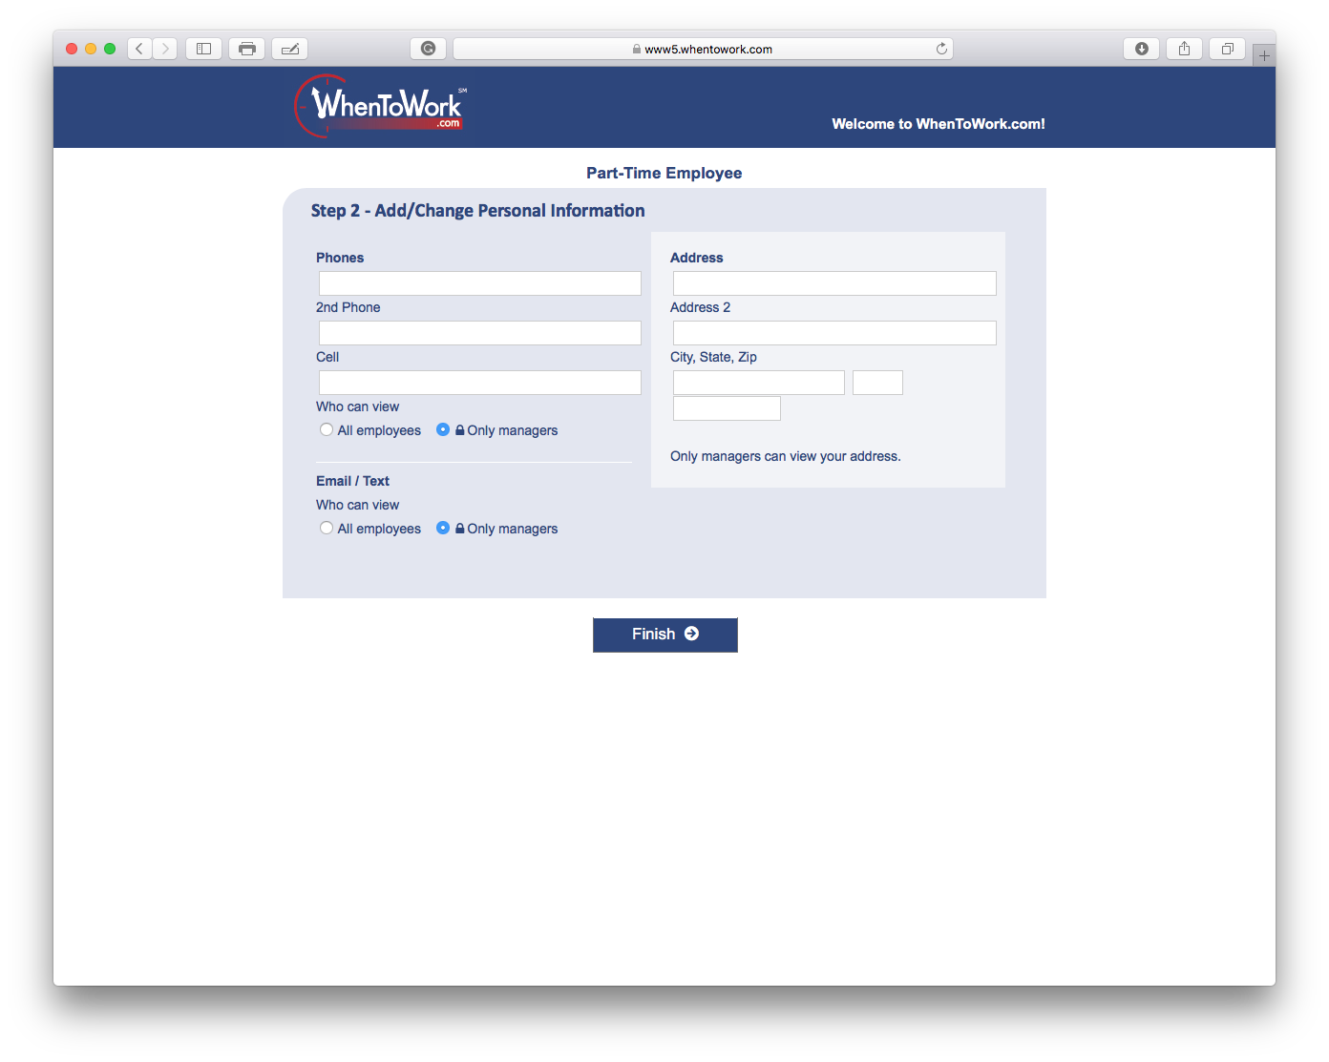
This page is optional at First Login.
Select Finish
Tip:
Your Personal Information is for Managers
(but you can allow others to see them to)

Slide 9
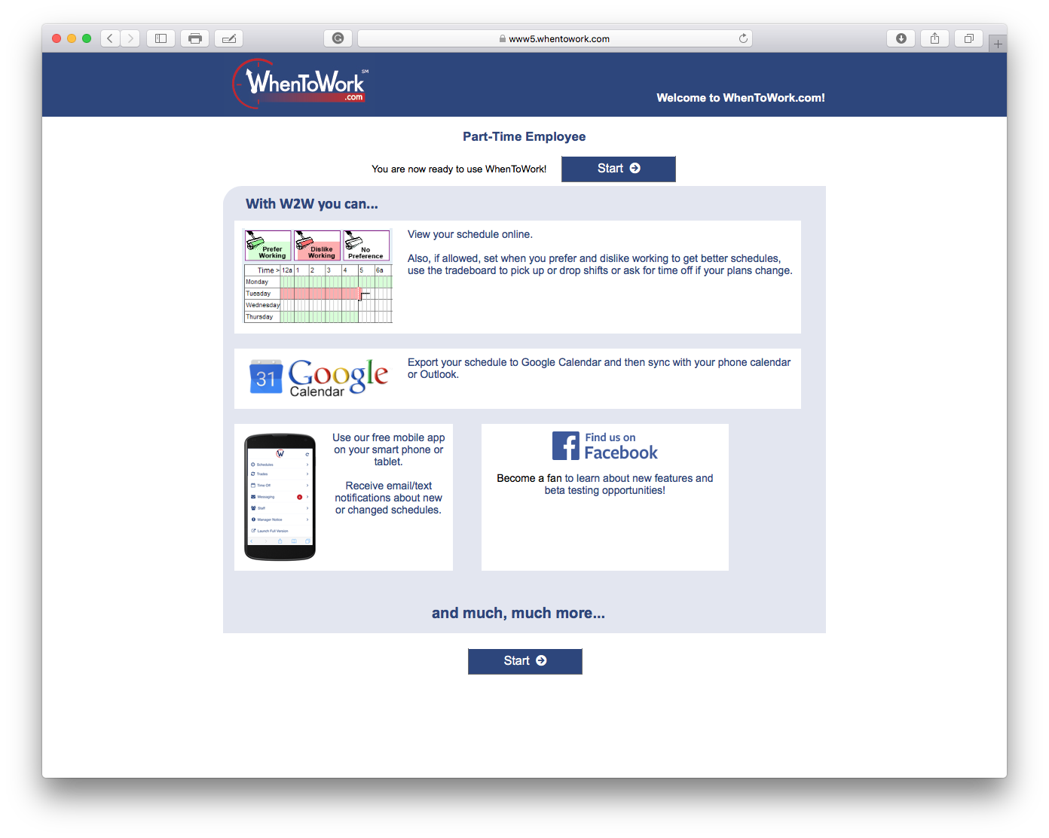
Tip:
Welcome to When2Work
Your Employee Scheduling System

